Slide 1
TCP/IP model development
The late-60s The Defense Advance Research Projects Agency (DARPA) originally developed Transmission Control Protocol/Internet Protocol (TCP/IP) to interconnect various defense department computer networks.
The Internet, an International Wide Area Network, uses TCP/IP to connect networks across the world.

Slide 2
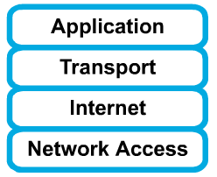
4 layers of the TCP/IP model
Layer 4: Application
Layer 3: Transport
Layer 2: Internet
Layer 1: Network access
It is important to note that some of the layers in the TCP/IP model have the same name as layers in the OSI model.
Do not confuse the layers of the two models.

Slide 3
The network access layer
Concerned with all of the issues that an IP packet requires to actually make the physical link. All the details in the OSI physical and data link layers.
  Electrical, mechanical, procedural and functional specifications.
  Data rate, Distances, Physical connector.
  Frames, physical addressing.
  Synchronization, flow control, error control.

Slide 4
The internet layer
Send source packets from any network on the internetwork and have them arrive at the destination independent of the path and networks they took to get there.
  Packets, Logical addressing.
  Internet Protocol (IP).
  Route , routing table, routing protocol.

Slide 5
The transport layer
The transport layer deals with the quality-of-service issues of reliability, flow control, and error correction.
  Segments, data stream, datagram.
  Connection oriented and connectionless.
  Transmission control protocol (TCP).
  User datagram protocol (UDP).
  End-to-end flow control.
  Error detection and recovery.

Slide 6
TCP/IP Reference Model (cont)
3. Transport layer (layer 3)
  Allows end-to-end communication
  Connection establishment, error control, flow control
  Two main protocols at this level
    Transmission control protocol (TCP),
      Connection oriented
        Connection established before sending data
        Reliable
    user datagram protocol (UDP)
      Connectionless
        Sending data without establishing connection
        Fast but unreliable

Slide 7
The application layer
Handles high-level protocols, issues of representation, encoding, and dialog control.
The TCP/IP combines all application-related issues into one layer, and assures this data is properly packaged for the next layer.
  FTP, HTTP, SMNP, DNS ...
  Format of data, data structure, encode …
  Dialog control, session management …

Slide 8
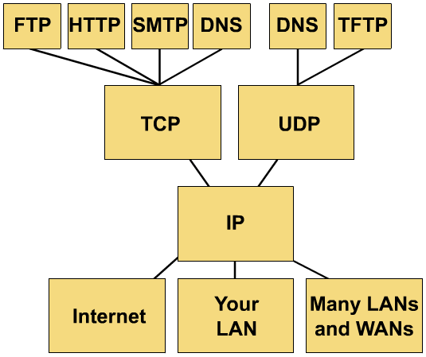
TCP/IP protocol stack

Slide 9
TCP/IP Reference Model
Layer
Protocols
Application
HTTP
TELNET
FTP
SMTP
SNMP
Transport
TCP
UDP
Internet
IP
ICMP
Network Access
(Host-to-network)
ETHERNET
PACKET RADIO

Slide 10
Protocols at the application layer
HTTP:
  browser and web server communicatin
FTP :
  file transfer protocol
TELNET:
  remote login protocol
POP3: Retrieve email
  POP3 is designed to delete mail on the server as soon as the user has downloaded it
IMAP (Internet Message Access Protocol )
  Retrieve emails,
  retaining e-mail on the server and for organizing it in folders on the serve

Slide 11
Protocols at the transport layer
    Transmission control protocol (TCP),
      Connection oriented
        Connection established before sending data
        Reliable
    user datagram protocol (UDP)
      Connectionless
        Sending data without establishing connection
        Fast but unreliable

Slide 12
Protocol at the network layer
IP
  Path selection ,
  routing and addressing
ICMP (Internet Control Message Protocol )
  sends error messages relying on IP
    a requested service is not available
    a host or router could not be reached

Slide 13
Protocols at the link layer
Ethernet
  Uses CSMA/CD
Token Ring

Slide 14
Data Encapsulation In TCP/IP
At each layer in the TCP/IP protocol stack
    Outgoing data is packaged and identified for delivery to the layer underneath
PDU – Packet Data Unit – the “envelop” information attached to a packet at a particular TCP/IP protocol
    e.g. header and trailer
Header
    PDU’s own particular opening component
    Identifies the protocol in use, the sender and intended recipient
Trailer (or packet trailer)
  Provides data integrity checks for the payload

Slide 15
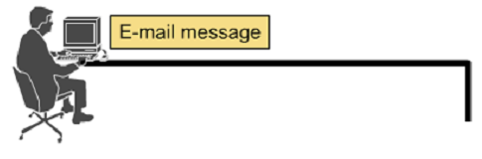




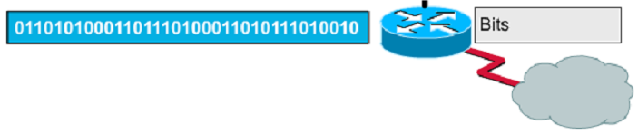
Encapsulation example: E-mail

Slide 16
Data Formats
Application data
message
application
layer
transport
layer
TCP
header
data
TCP
header
data
TCP
header
data
segment
internet
layer
IP
header
TCP
header
data
packet
Network access
layer
Ethernet
header
IP
header
TCP
header
data
Ethernet
trailer
frame

Slide 17
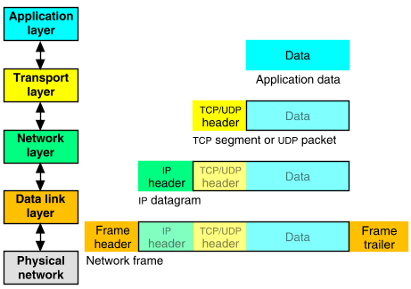
Packet Encapsulation (TCP/IP)
The data is sent down the protocol stack
Each layer adds to the data by prepending headers
22Bytes
20Bytes
20Bytes
4Bytes
64 to 1500 Bytes

Slide 18
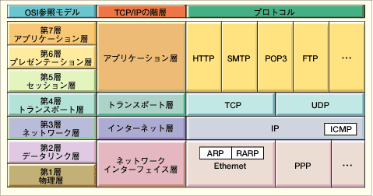
Comparing TCP/IP with OSI
OSI Model
TCP/IP Hierarchy
Protocols
7th
Application Layer
6th
Presentation Layer
Application Layer
5th
Session Layer
4th
Transport Layer
Transport Layer
3rd
Network Layer
Internet Layer
2nd
Link Layer
Network Access Layer
1st
Physical Layer
Network Access Layer : includes device driver and network interface card
Internet Layer : handles the movement of packets, i.e. Routing
Transport Layer : provides a reliable flow of data between two hosts
Application Layer : handles the details of the particular application

Slide 19
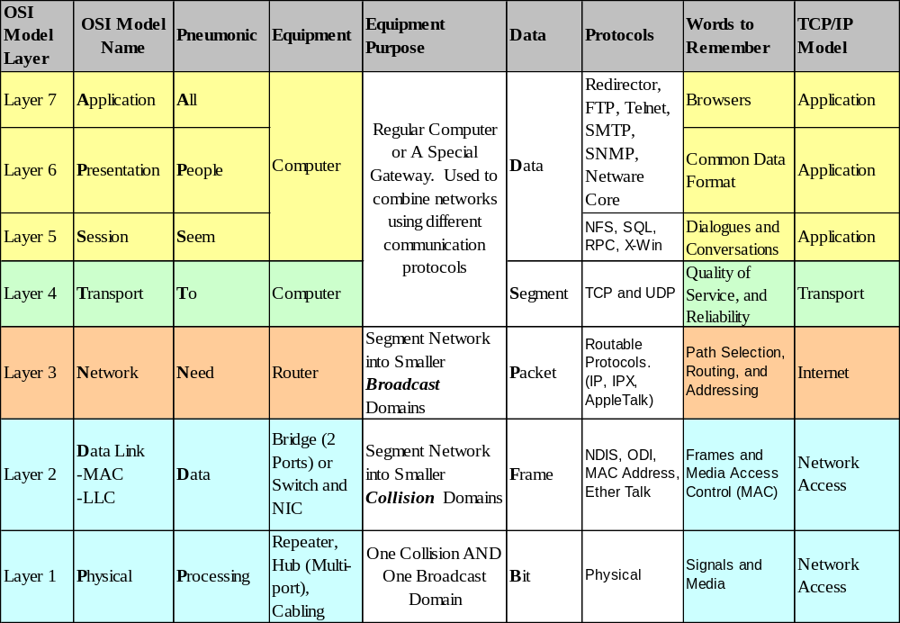
How the OSI and TCP/IP Models Relate in a Networking Environment

Slide 20
Student Activity
Which layer information is used by a Router?
Which layer information is used by a Switch?
Which layer is used by a Hub?
Which layer does the TCP protocol operate at?
Which layer does the IP protocol operate at?
What is a PDU?
What is meant by data encapsulation?
What is the PDU at the Transport layer?
What is the PDU at the Network layer?
How many layers are in the TCP/IP protocol model?
Show with a diagram how the OSI and TCP/IP models compare
At what level of the OSI model does the HTTP protocol work?
At what level of the TCP/IP model does the UDP protocol work?
When the PDU is a packet state what the corresponding layers are for the OSI and the TCP/IP models
When data formatting is considered state what the corresponding layers are for the OSI and the TCP/IP models

Slide 21

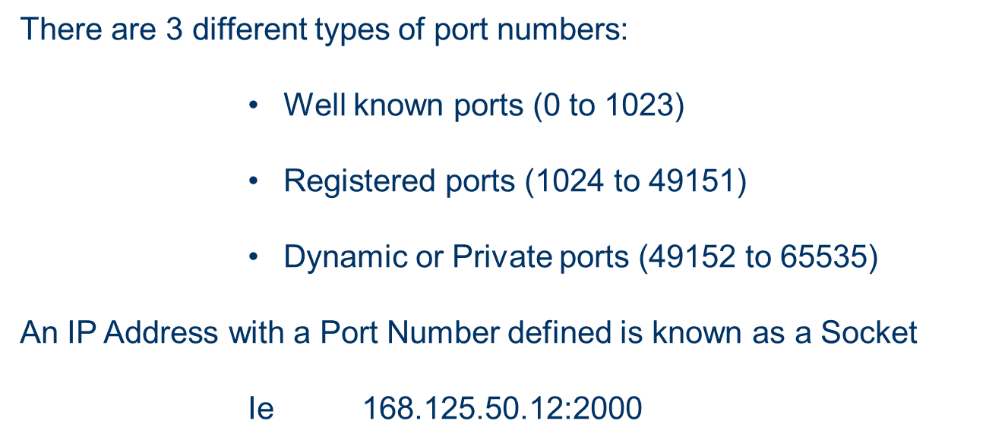
Port 0
Port 1
Ports/Sockets
Port 65535

Slide 22
Well Known Ports
These are reserved for services and applications
By defining these ports for server applications, client applications can be programmed to request a connection to a specific port and its associated service
Some of these are:
Port Number | Application | Protocol
20 | FTP (Data) | TCP
21 | FTP (Control) | TCP
23 | Telnet | TCP
25 | SMTP | TCP
53 | DNS | UDP
67 | DHCP | UDP
69 | TFTP | UDP
80 | HTTP | TCP
110 | POP3 | TCP
443 | HTTPS | TCP
520 | RIP | UDP

Slide 23
Protocols
For a great graphic of protocol stacks in relationship to the OSI model, visit http://www.lex-con.com/osimodel.htm
For more information on the OSI model, including an animated graphic and various protocol information, visit http://www.certyourself.com/OSIguide.shtml

Slide 24
Reading
http://www.howtheosimodelworks.com , Charles C. Botsford, 2001.
https://cisconetacad.net, Cisco Academy Connection Editors, 2002.
http://www.hawkclan.com/zxonly/iso/slide2.html
http://www.pku.edu.cn/academic/research/computer-center/tc/html/TC0102.html, William L. Whipple &
Sharla Riead, 1997.
http://www.lex-con.com/protocols/ip.htm, Lexicon Computing, Dallas TX, 2002

